Slide 2
Firms’ decisions
A cost curve describes the minimum cost at which a firm can produce various amounts of output.
Once we know its cost curve, a fundamental problem faced by every firm: How much should be produced
How does a firm decide how much product to supply that maximizes its profit? It depends upon the firm’s
technology
market environment
competitors’ behaviors

Slide 3
Market Environments
Economists generally classify markets into four broad types:
Pure Competition: Many firms, all making the same product. Each firm’s output level is small relative to the total.
Monopolistic Competition: Many firms each making a slightly different product. Each firm’s output level is small relative to the total.
Monopoly: Just one seller that determines the quantity supplied and the market-clearing price.
Oligopoly: A few firms, the decisions of each influencing the payoffs of the others.

Slide 4
Characteristics of market structure
Market Structure | Examples | No. Of producers | Type of product | Power of firm over price | Entry barriers | Nonprice competition
Perfect Competition | Agricultural product | Many | Standardized | None | Low | None
Monopolistic Competition | Retail trade | Many | Differentiated | Some | Low | Advertising and product differentiation
Oligopoly | Oil , Steel and Auto | Few | Standardized or Differentiated | Some | High | Advertising and product differentiation
Monopoly | Public utilities | One | Unique | Considerable | Very High | Public relations

Slide 5
Perfect Competition
A firm in a perfectly competitive market has no influence over the market price for its product. The firm is a market price-taker.
In a perfectly competitive industry, market price is determined by the intersection of the market demand and supply curves.
The firm is free to vary its own price.
If the firm sets its own price above the market price then the quantity demanded from the firm is zero.
If the firm sets its own price below the market price then the quantity demanded from the firm is the entire market quantity-demanded.

Slide 6
Demand curve faced by the individual firm
$/output unit
Market Supply
p’
p^{e}
p”
Market Demand
y
At a price of p’, zero is demanded from the firm.
At a price of p” the firm faces the entire market demand.

Slide 7
$/output unit
The demand curve for the perfectly competitive firm is horizontal (i.e., completely elastic). Because a perfect competitor has such a small fraction of the market that it can sell all it wants at the market price.
p’
p^{e}
p”
Market Demand
Y

Slide 8
Assumptions for perfectly competitive market
The model of perfect competition rests on three basic assumptions:
Price Taking: Each individual firm sells a sufficiently small proportion of total market output, its decisions have no impact on market price. Thus, each firm takes the market price as given.
Product Homogeneity: The products of all of the firms in a market are perfectly substitutable with one another.
Free Entry and Exit: Buyers can easily switch from one supplier to another, and suppliers can easily enter or exit a market.

Slide 9
Demand curve faced by the individual firm and market
We need to distinguish between market demand curves and the demand curves faced by individual firms.
Because it is a price taker, the demand curve facing an individual competitive firm is given by a horizontal line. The firm's sales will have no effect on price.
The market demand curve shows how much all consumers will buy at each possible price. It is downward sloping because consumers buy more quantity at a lower price.
Price is determined by the interaction of all firms and consumers in the market, not by the output decision of a single firm.

Slide 10
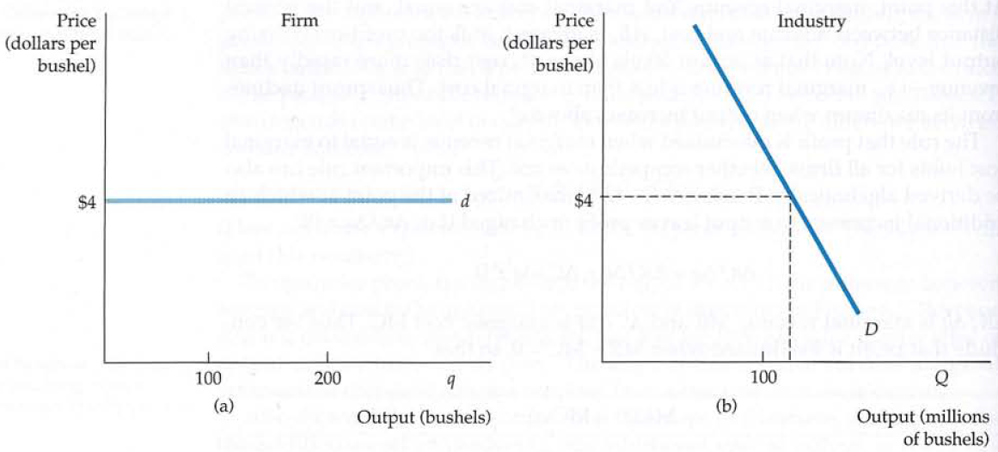
Example

Slide 11
The Firm’s Short-Run Supply Decision
Each firm is a profit-maximizer and in a short-run, how does each firm choose its output level? In the short run, a firm operates with a fixed amount of capital and must choose the levels of its variable inputs (labor and materials) to maximize profit.
The firm’s profit (∏) is expressed as total revenue (TR) minus total cost (TC).
A firm’s total revenue is found by multiplying its output by the price at which it sells that output.
For a price p and output y,

Slide 12
So the profit maximization objective is
Π(y)
y_{s}*
y

Slide 13
The first-order maximum profit condition is
That is,
So at a profit maximum with y_{s}* > 0, the market price p equals the marginal cost of production at y = y_{s}*.
The slope of the revenue curve is marginal revenue: the change in revenue resulting from a one-unit increase in output.

Slide 14
The second-order maximum profit condition is
That is,
So at a profit maximum with y_{s}* > 0, the firm’s MC curve must be upward-sloping.

Slide 15
Marginal cost
$/output unit
At y = y_{s}*, p = MC and slope of MC upwards.
y = y_{s}* is profit-maximizing.
p^{e}
MC_{s}(y)
y’
y_{s}*
y
At y = y’, p = MC and slope of MC downwards. y = y’ is profit-minimizing. So a profit-max supply level can lie only on the upwards sloping part of the firm’s MC curve.

Slide 16
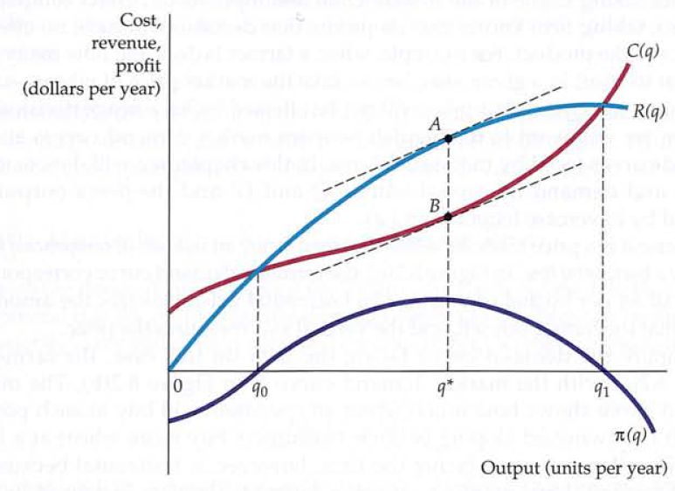
A firm chooses output q*, so that profit, the difference AB between revenue R and cost C, is maximized. At that output, marginal revenue (the slope of the revenue curve) is equal to marginal cost (the slope of the cost curve).

Slide 17
A perfectly competitive firm should choose its output so that marginal cost equals price
The output choices of individual firms lead to a supply curve for an entire industry.
Because competitive firms take price as fixed, this is a rule for setting output, not price.

Slide 18
Example
Units of Output | Price($) | Total Revenue ($) | Total Fixed cost ($) | Total variable cost ($) | Total cost ($) | Total profit ($) | Marginal revenue | Marginal cost
0 | 10 | 0 | 1 | 0 | 1 | -1 | 10 | 2
1 | 10 | 10 | 1 | 3 | 4 | 6 | 10 | 4
2 | 10 | 20 | 1 | 8 | 9 | 11 | 10 | 6
3 | 10 | 30 | 1 | 15 | 16 | 14 | 10 | 8
4 | 10 | 40 | 1 | 24 | 25 | 15 | 10 | 10
5 | 10 | 50 | 1 | 35 | 36 | 14 | 10 | 12
6 | 10 | 60 | 1 | 48 | 49 | 11 | 10 | 14
7 | 10 | 70 | 1 | 63 | 64 | 6 | 10 | 16
8 | 10 | 80 | 1 | 80 | 81 | -1 | 10 | 18
9 | 10 | 90 | 1 | 99 | 100 | -10 | 10

Slide 19
The prevailing market price is $7 per unit. What is the firm's profit maximizing output level?
Output (Units) | Total Cost ($)
0 | 50
10 | 120
20 | 170
30 | 210
40 | 260
50 | 330
60 | 430

Slide 20
Economic Profit in the Short Run
A firm’s economic profit is the difference between total revenue and total cost. Total cost is the opportunity cost of producing a certain good or service. When we speak of economic profit we are speaking of a firm’s total revenue less the total opportunity cost of its operations.
A perfectly competitive firm maximizes economic profit at the output level at which the total revenue curve and the total cost curve have the same slope.
A profit-maximizing firm should increase output until the marginal benefit of an additional unit equals the marginal cost. The marginal benefit of selling an additional unit is measured as marginal revenue. Finding the output at which marginal revenue equals marginal cost is thus an application of our marginal decision rule.

Slide 21
Economic Losses in the Short Run
In the short run, a firm has one or more inputs whose quantities are fixed. That means that in the short run the firm cannot leave its industry. Even if it cannot cover all of its costs, including both its variable and fixed costs, going entirely out of business is not an option in the short run. The firm may close its doors, but it must continue to pay its fixed costs. It is forced to accept an economic loss, the amount by which its total cost exceeds its total revenue.
Shut-down is not the same as going out of business. Shutting-down means producing no output (but the firm is still in the industry and suffers its fixed cost). Exit means leaving the industry, which the firm can do only in the long-run. A firm shuts down by closing its doors; it can reopen them whenever it expects to cover its variable costs.

Slide 22
The Firm’s shutting down condition
Not every point on the upward-sloping part of the firm’s MC curve represents a profit-maximum.
The firm’s profit function is
Where, F= firm’s fixed cost and c_{v}(y) is firm’s variable cost
If the firm chooses y = 0 then its profit is
This is the loss due to shutting down

Slide 23
So the firm will choose an output level y > 0 only if
Equivalently, only if
The minimum level of average variable cost, which occurs at the intersection of the marginal cost curve and the average variable cost curve, is called the shutdown point. Any price below the minimum value of average variable cost will cause the firm to shut down. If the firm were to continue producing, not only would it lose its fixed costs, but it would also face an additional loss by not covering its variable costs.

Slide 24
The shutdown point comes where revenues just cover variable costs or Where losses are equal to fixed costs. When the price falls below average variable costs, losses are greater than fixed costs hence, the firm will better off by shutting down.
In a short run, a perfectly competitive firm will choose an output level (y > 0) only if the price is above the minimum average variable cost (p>AVC_{min}). To determine the level of output where the average variable cost is minimum is at

Slide 25
p > AVC_{s}(y) → y_{s}* > 0.
$/output unit
p < AVC_{s}(y) → y_{s}* = 0.
MC_{s}(y)
Shutdown point
AC_{s}(y)
AVC_{s}(y)
The firm’s short-run supply curve
y

Slide 26
Perfect Competition in the Long Run
Economic profits and losses play a crucial role in the model of perfect competition. The existence of economic profits in a particular industry attracts new firms to the industry in the long run. As new firms enter, the supply curve shifts to the right, price falls, and profits fall. Firms continue to enter the industry until economic profits fall to zero. If firms in an industry are experiencing economic losses, some will leave. The supply curve shifts to the left, increasing price and reducing losses. Firms continue to leave until the remaining firms are no longer suffering losses— until economic profits are zero.
Economic profit equals total revenue minus total cost, where cost is measured in the economic sense as opportunity cost.

Slide 27
Accountants include only explicit costs in their computation of total cost. Explicit costs include charges that must be paid for factors of production such as labor and capital, together with an estimate of depreciation. Profit computed using only explicit costs is called accounting profit.
Suppose there are two industries in the economy, and that firms in Industry A are earning economic profits. Firms in Industry B are experiencing economic losses. Given easy entry and exit, some firms in Industry B will leave it and enter Industry A to earn the greater profits available there. As they do so, the supply curve in Industry B will shift to the left, increasing prices and profits there.

Slide 28
As former Industry B firms enter Industry A, the supply curve in Industry A will shift to the right, lowering profits in A. The process of firms leaving Industry B and entering A will continue until firms in both industries are earning zero economic profit.
That suggests an important long-run result: Economic profits in a perfectly competitive markets will, in the long run, be driven to zero in all industries.

Slide 29
The Firm’s Long-Run Supply Decision
In the long run, a firm is free to adjust all of its inputs. New firms can enter any market; existing firms can leave their markets.How does the firm’s long-run supply decision compare to its short-run supply decisions?
A competitive firm’s long-run profit function is
The long-run cost c(y) of producing y units of output consists only of variable costs since all inputs are variable in the long-run.

Slide 30
The firm’s long-run supply level decision is to
The 1st and 2nd-order maximization conditions are, for y* > 0,

Slide 31
Additionally, the firm’s economic profit level must not be negative since then the firm would exit the industry. So,
The ultimate beneficiaries of the innovative efforts of firms are consumers. Firms in a perfectly competitive world earn zero profit in the long-run. While firms can earn accounting profits in the long-run, they cannot earn economic profits. Zero economic profit signifies not that firms are performing poorly, but rather that the industry is competitive.

Slide 32
The firm’s long-run supply curve
$/output unit
MC(y)
p > AC(y)
AC(y)
y

